Slide 1

Spacex predictions
IBM capstone project

Slide 2
Outline
Executive Summary
Introduction
Methodology
Results
Conclusion
Appendix

Slide 3
Executive summery
Data was collected from the SpaceX website and Wikipedia page using API and web-scraping. After data exploration using both SQL, folium maps and data visualizations, The relevant features were selected in order to predict successful lending. After processing the data and preparing it for training, several machine learning model were tested and trained using hyper parameters optimization techniques such as Gridsearch.
The machine learning models that were developed (logistic regression, decision tree classifier, SVM, KNN) have shown relative success rate of 83.3%. The success rate was identical in all models. All models had a problem with false positives.

Slide 4
Introduction
Backgroung
SpaceX set itself the goal of making space travel more affordable and sustainable after recognizing it as the next great stage of human society development. The first stage is making reusable rockets for the first stage of travel.
Problem
Each launch and landing attempt is very expensive and complicated. Therefore, being able to partly predict the probability of an attempt succeeding could save the company time, money, and effort and help understand what might make an attempt more likely to succeed.

Slide 5

methodology
Section 1

Slide 6
Methodology
Data collection methodology
Data collected from SpaceX API and Wikipidia page
Perform data wrangaling
Used the landing success as label
Perform exploratory data analysis (EDA) using visualization and SQL
Perform interactive visual analytics using Folium and Plotly Dash
Perform predictive analysis using classification models
trained models and tuned them using gridsearch

Slide 7
Data collection
The data was collected and combined from 2 different sources, SpaceX public API and SpaceX Wikipedia page using web scraping.
The Process of collecting the data will be presented in the next 2 slides.

Slide 8
Data collection – spacex public api (link)
SpaceX API request
JSON file and lists
Normalize to pd.DataFrame
Keep only Falcon 9 launches
Dictionary to DataFrame
Filter relevant data into dictionary
fill PayloadMass missing values with mean

Slide 9
Data collection – Wikipedia web scraping (link)
Get page HTML
Pars with BeautifulSoup
Get relevant launch table
Dictionary to DataFrame
Collect data to dictionary

Slide 10
Data Wrangling (link)
Create outcome column with the mission success and landing location
Generate binary label column where 1=success and 0=failure out of the outcome column

Slide 11
EDA with data visualization (link)
EDA performed on variables: payload mass, launch site, flight number, class, year and orbit
Plotted the following plots:
Flight number & payload mass/launch site/orbit
Payload mass & launch site/orbit
Orbit & success rate
Used line charts, scatter plots and bar plots to explore relationships between variables and to decide if the feature should be used in the ML models

Slide 12
EDA with sql (link)
Loaded data into an sqlite3 instance in a Jupiter notebook
Used Jupiter magic commands to integrate SQL and query the data
For better understanding of the data, used several queries:
Unique launch sites
Total payload mass
Average payload mass
First successful landing
Success in different payload mass ranges
Count success and failure
Several other queries to present the data in different ways

Slide 13
Interactive map with folium (link)
Created an interactive map in order to show the launch sites and their distance to different landmarks such as: coast, city, railway and highway
This allows better understanding of each location and why it might and might not be prone to higher success rate

Slide 14
Dashboard with Plotlydash (link)
Dashboard contains a scatter plot and a pie chart
The scatter plot uses 2 inputs: several sites or one site, and payload mass range
The scatter plot is used to the success rates in different mass classes and launch sites
The pie chart shows success rate in all, some or one launch sites
The pie chart shows us which launch sites are most likely to succeed

Slide 15
Predictive analysis – classification (link)
Split label column from X data
Fit_transform with StandartScaler
Train_test_split with test size 0.2
Calculate accuracy scores for models
Train: SVM, decision tree, Log Red, KNN models
HP optimization with Grid Search (cv=10)
Compare scores and confusion matrix to find opt model

Slide 16
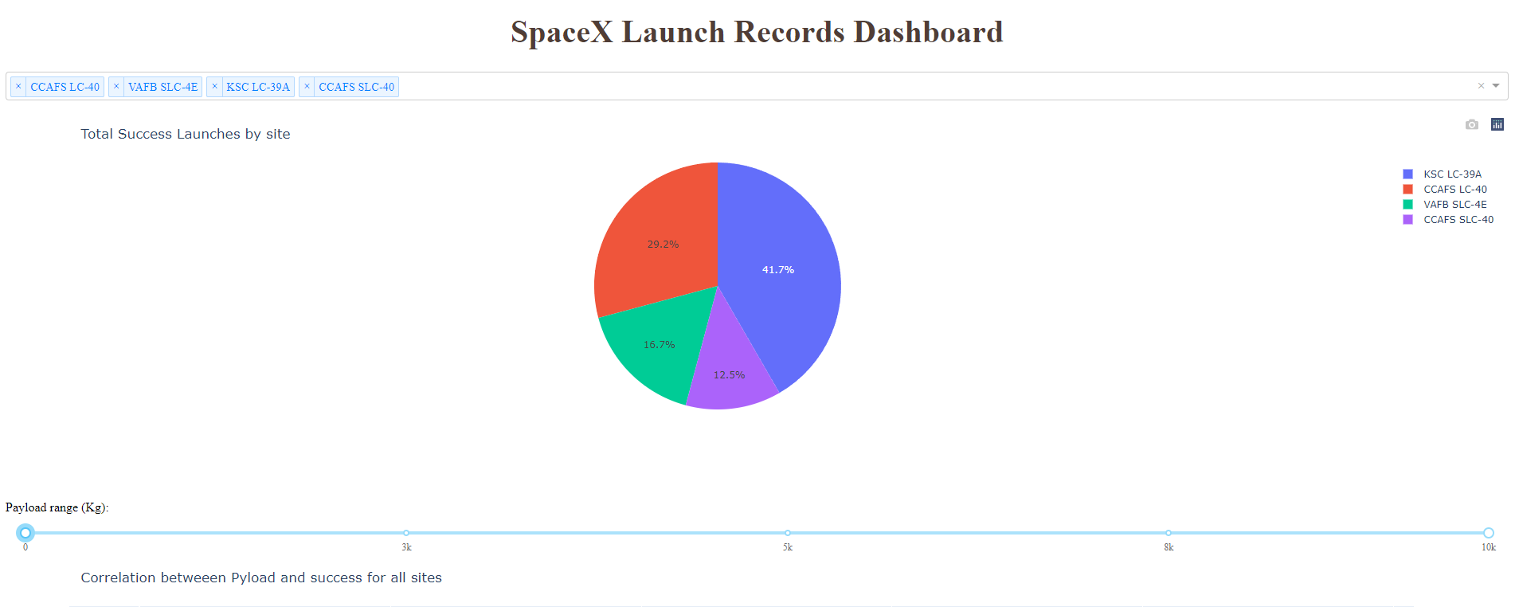
Results
Plotly dashboard preview.
the several few slides will showcase the EDA, visualization and modeling results using screenshots.

Slide 17
Insights drawn from EDA
Section 2

Slide 18
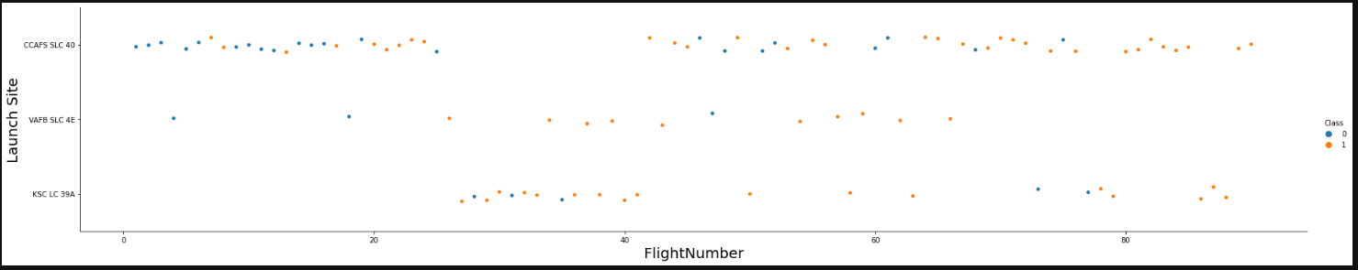
Flight number vs. launchsite
This plot shows successful and unsuccessful landings in each site over time (orange=success). As we can see the first few attempts were all failures but later on the success rate goes up on all three. The first launch site appears to be the most well used.

Slide 19
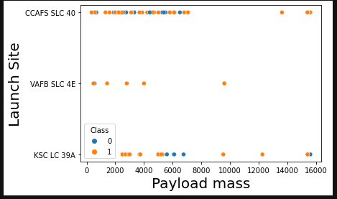
Payload vs. launch site
As we can see, the first site uses almost only flights with <8000 KG payload mass.
While the second uses even lower mass and the third is more spread out.

Slide 20
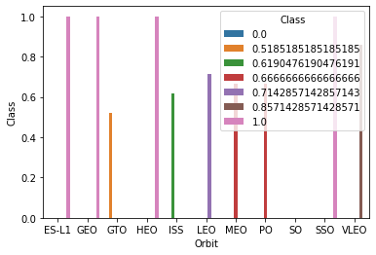
Success rate vs. orbit type
There are 4 orbit types with 100% success rate while the rest have about 0.65 and SO has never succeded

Slide 21
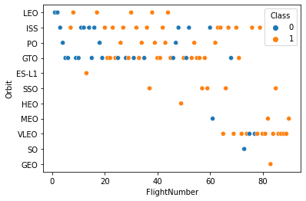
Flight number vs. orbit type
As time progressed the launch site preferences have changed.
There is no obvious correlation.
The success rate seems to be better at lower orbit but that might also be because those are the later trials and the company is more experienced

Slide 22
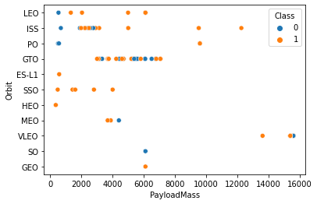
Payload vs orbit type
There appears to be some correlation between the two features.
Each orbit has a pretty specific payload mass range.

Slide 23
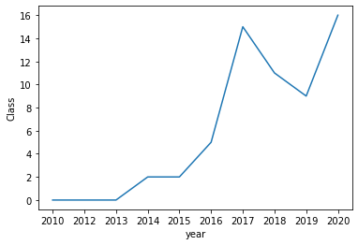
Launch success yearly trend
Success rises surely after 2013 and has a dip in 2018 then rises again.
Success in the last year is fairly high.

Slide 24
EDA with SQL
Section 2

Slide 25
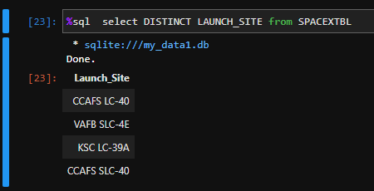
All launch site names
Query DISTINCT launch site names from the Database

Slide 26
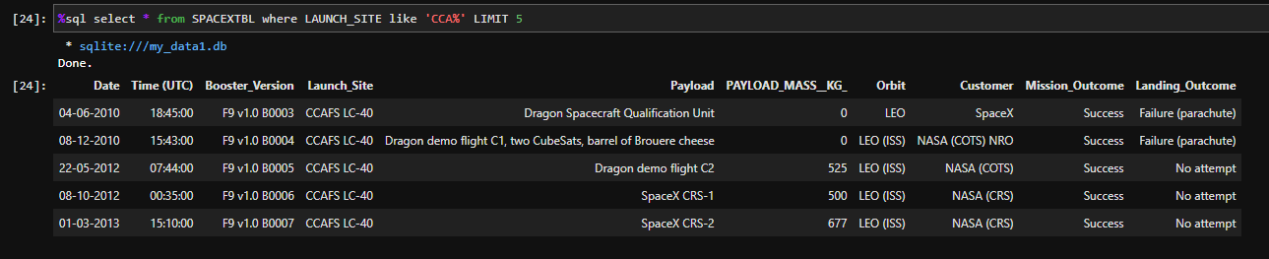
Launch site names beginning with ‘CAA’
Top 5 records in which the launch site name starts with “CAA”

Slide 27
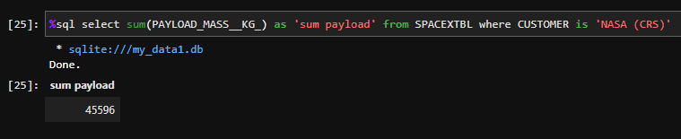
Total payload mass from nasa
Sum of the total payload mass (KG) of all flights ordered by NASA

Slide 28
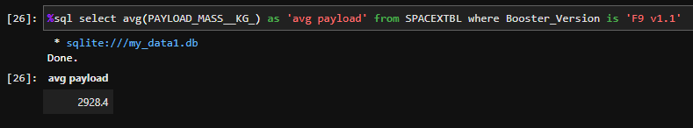
Average payload mass by F9v1.1
Average payload mass of all flights that used a booster of type F9v1.1
This appears to be relatively low.

Slide 29
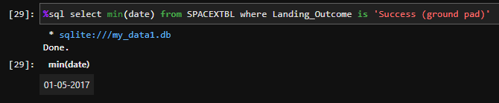
First successful ground landing date
This is the date of the first successful landing.

Slide 30
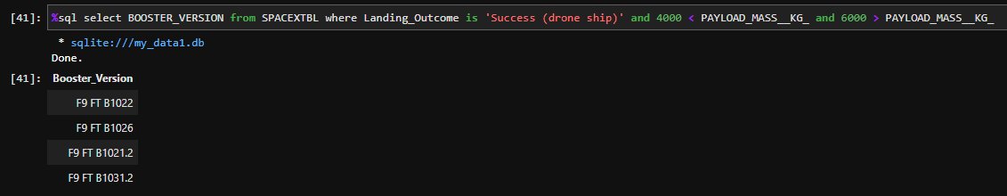
Successful Drone ship landing with payload between 4000-6000
Query shows the 4 successful landings in the 4000-6000 KG payload mass range.

Slide 31
Total number of each mission outcome
Finds how many failures and successes were there. It seems that there is a very positive ratio of success.

Slide 32
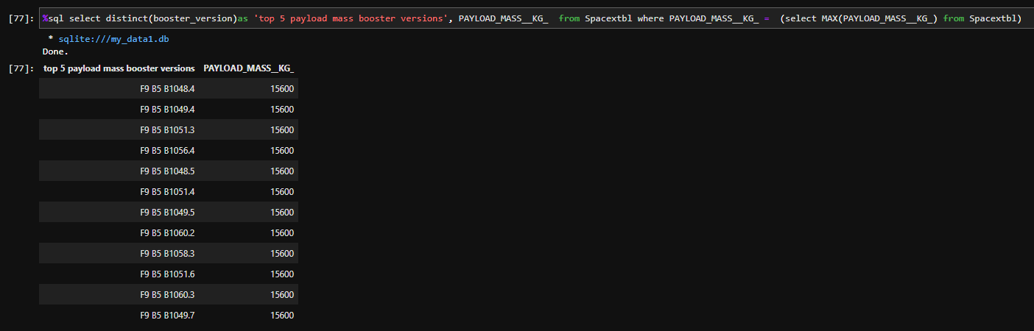
Boosters that carried maximum payload
Query shows all booster versions that carried the maximum payload mass (15600 kg)

Slide 33
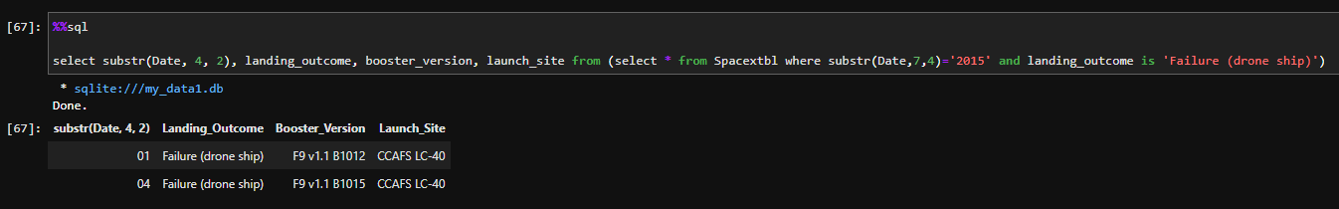
2015 Failed drone ship landing records
Shows the 2 failed landing attempts in 2015 on a drone ship.

Slide 34
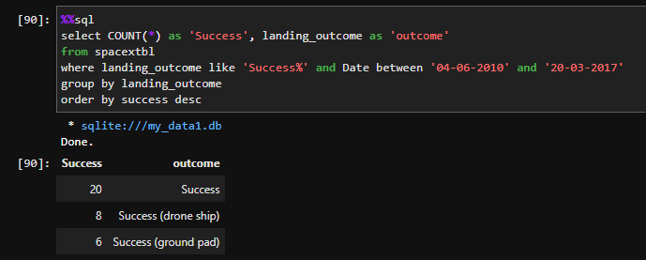
Ranking counts of successful landings between 2010-06-04 and 2017-03-20
Shows counts of all success types during the specified period.
There are a total of 34 successful landings during the period.

Slide 35
Launch sites proximities analysis
Section 3

Slide 36
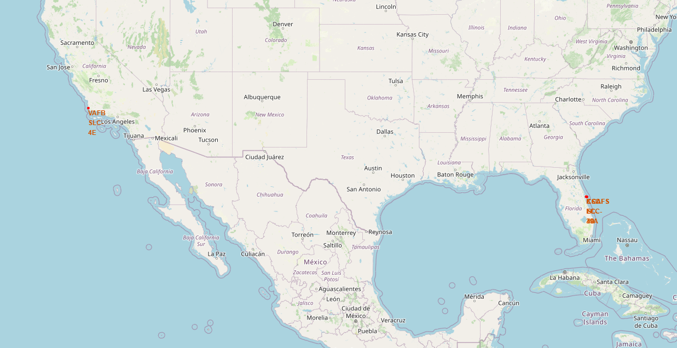
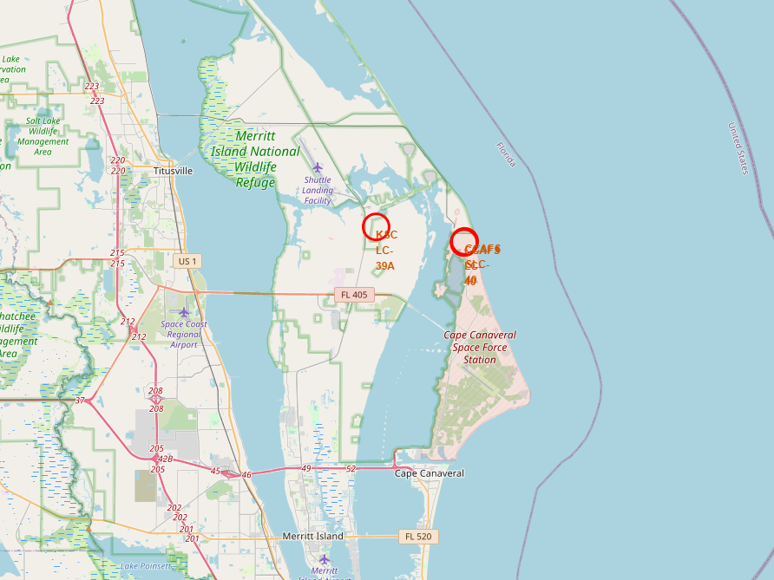
Launch site locations
The right map shows the zoomed in version of the left map which shows the exact locations of all launch sites.
The map shows that the sites are located at the 2 ends of the us next to the ocean.

Slide 37
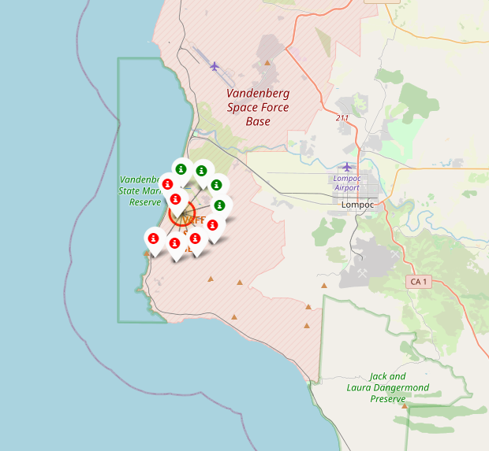
Color coded location markers group
The markers show each instance of landing attempt and weather it was successful.
Red=fail
Green=success

Slide 38
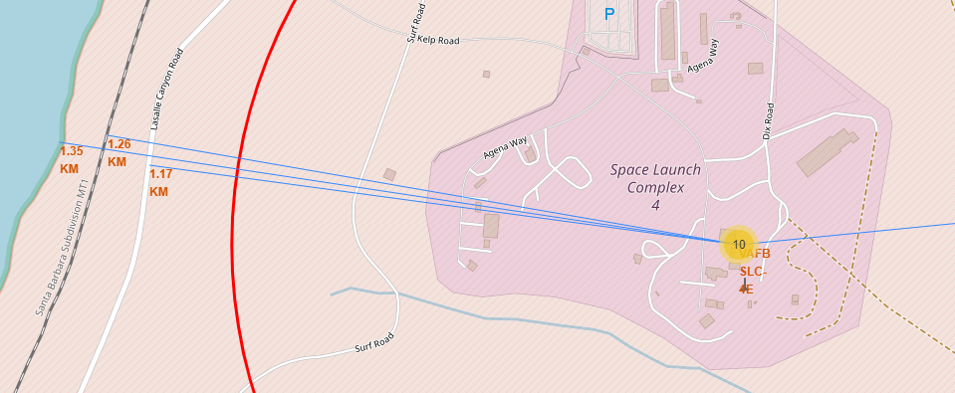
Content 01
This map and markers show the exact distance between the launch sites the nearest specified landmarks such as a road, shore line, and railway.

Slide 39
Build a dashboard with plotly dash
Section 4

Slide 40

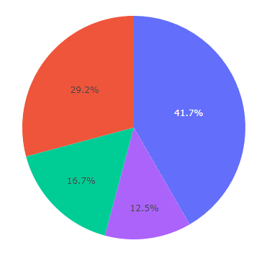
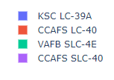
Successful launches by launch sites
This pie chart shows the number of successful launches in each launch site.
We can see nearly half are at KSC LC-39A.

Slide 41

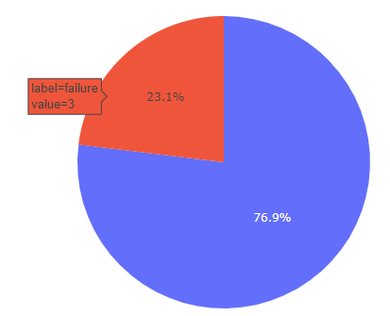

Most successful launch site
When selecting only one launch site the plot shows the success vs failure distribution for this site.
As we can see there is a fairly high rate of success in this site, which also explains why it has the most successes

Slide 42
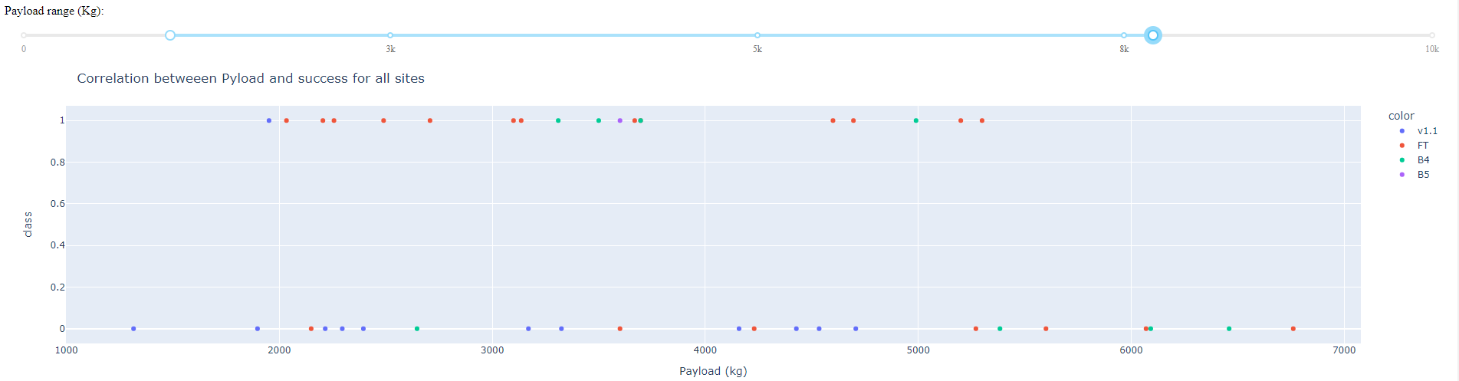
Payload mass vs. success vs. booster version
This scatter plot shows us the successful and failed attempts for each payload mass and helps us find a correlation. The color of the dot signifies the type of booster version.
It seems that booster type FT is the most common and has the most successes, especially at lower paylod mass ranges.

Slide 43
Predictive analysis (classification)
Section 5

Slide 44
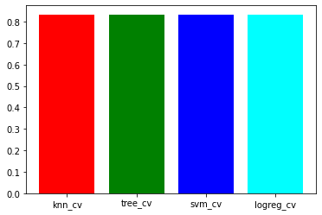
Classification accuracy
It seems that all of the models have the exact same success rate of ~83.3%
This might be because of the small test size.
But for now there does not appear to be any difference between the models.

Slide 45
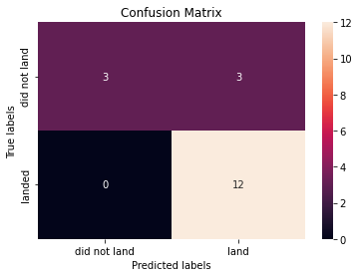
Confusion matrix
The confusion matrix shows us that the model had no problem with false negatives but as significant problem with false positives.

Slide 46
conclusion
We were tasked with developing a predictive ML model to predict the outcome of landing attempts by the SpaceX reusable 1st stage rockets
We scraped and collected data from SpaceX itself and from Wikipedia
The data was converted, cleaned and transformed in to a SQL DB
EDA was performed on the dataset for better understanding of the features and their relationships
4 machine learning models were created with accuracy of ~83.3% and a problem with false positives.
The model can be used but might improve with more data or other modeling methods.

Slide 47
Thank you

